Slide 1

Library Management System
By Yolanda and Stuart

Slide 2
Our project’s purpose
To create library management system that can be used to maintain the records of the library
To keep a record of –
Available books in the library
The number of books issued
The number of books returning
Members of the library

Slide 3
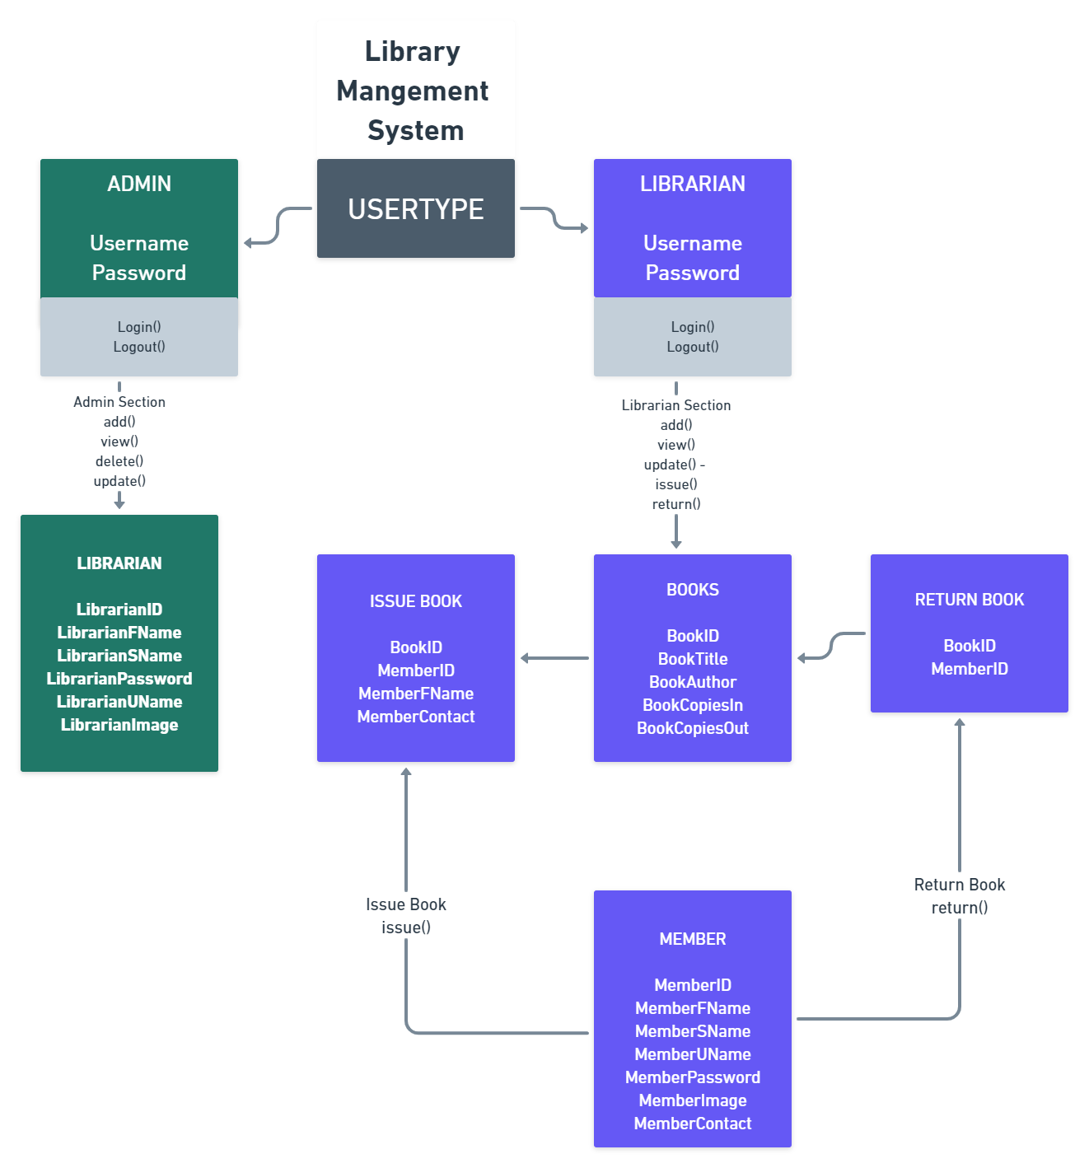
Library Management – Flow
Overview of library management flow process

Slide 4
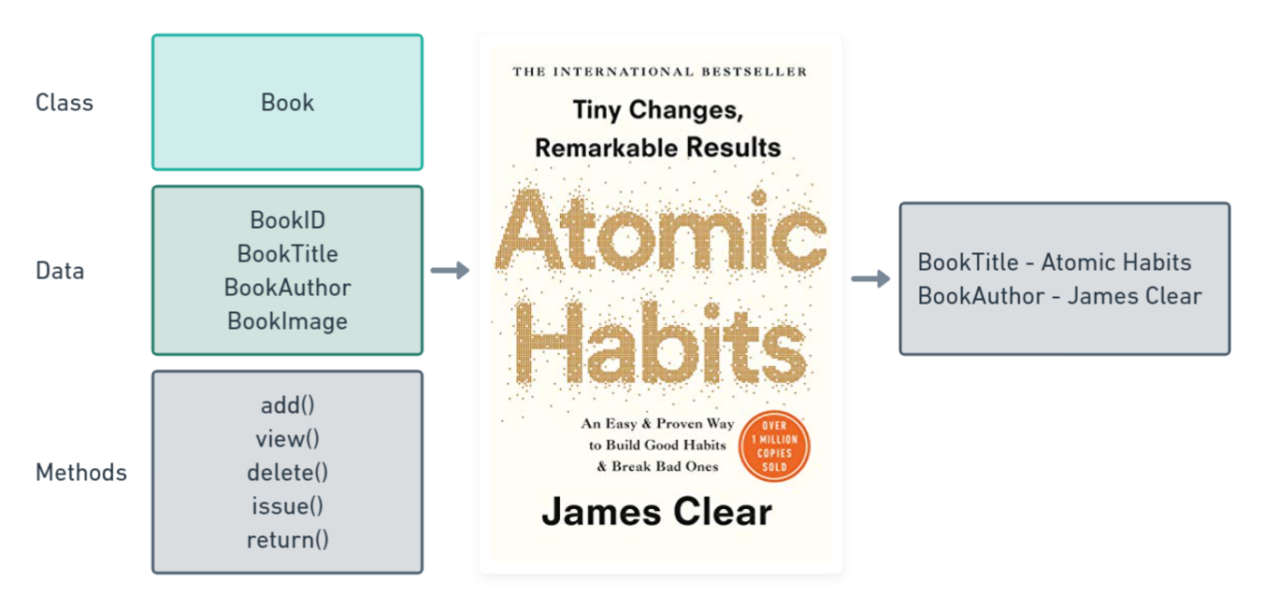
Objects – Books/Members/Librarians

Slide 5
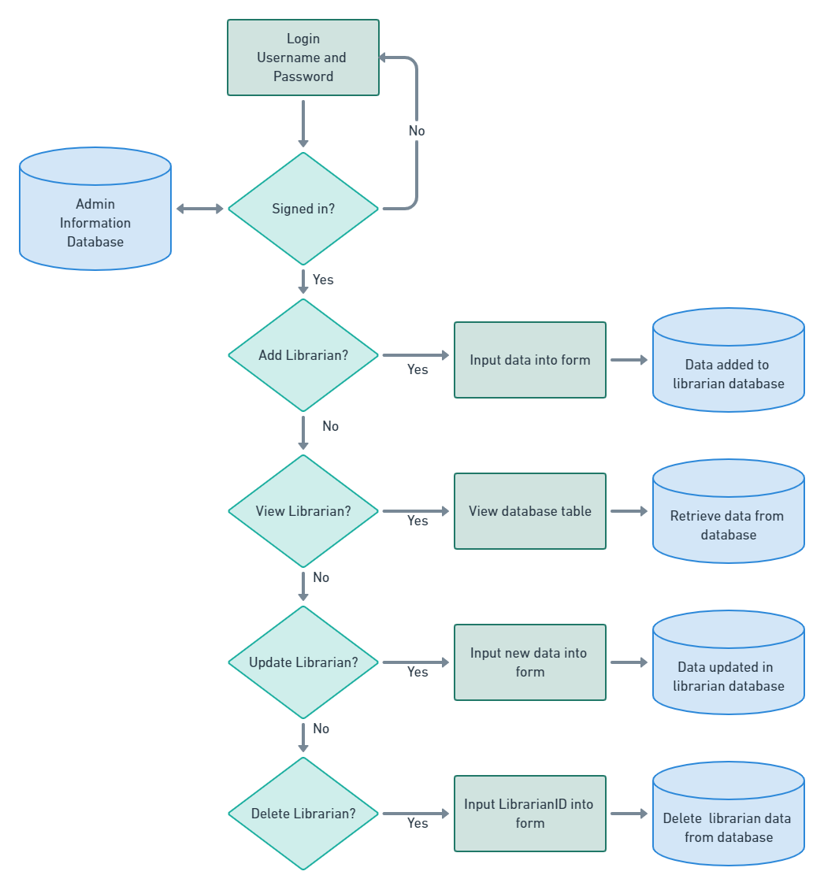
Administration - Flow
Logins into there own UI of the software
Manages the librarian records and data

Slide 6
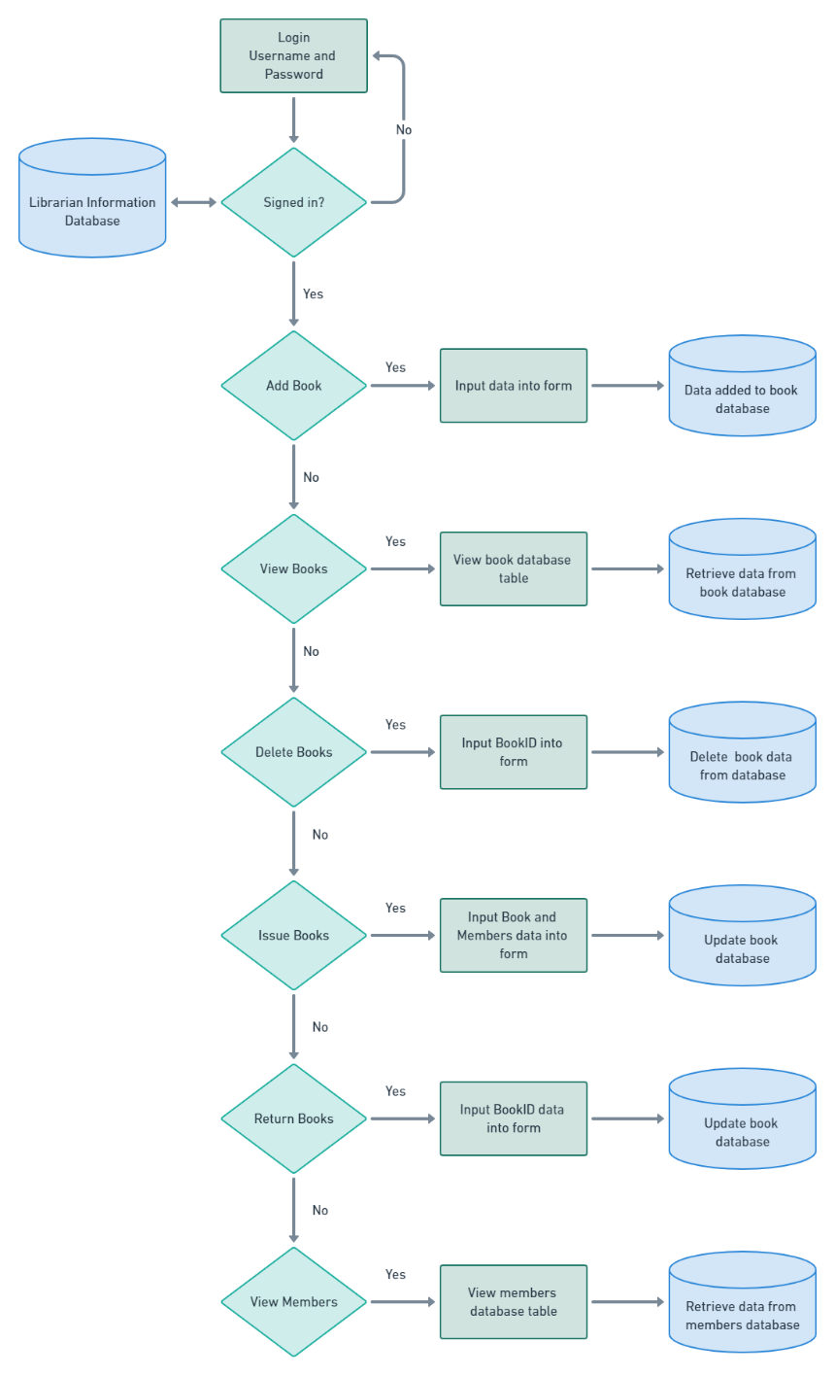
Librarian - Flow
Login to there own UI of the application
Manages the books and members data

Slide 7
Project Development Details
Integrated development environment (IDE)
NetBeans IDE 8.2
Technology
Java 2 Platform, Enterprise Edition (J2EE) - Java,JSP,Servlet
Java Database Connectivity (JDBC) - MySQL workbench
Design Pattern
Model, View and Controller (MVC)
Java Platform, Enterprise Edition (Java EE) – GlassFish Server

Slide 8
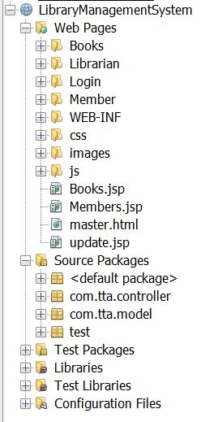
Project Structure
MVC
M = Model - com.tta.model
Java Class
Database Class
Database Query Class
V = View
.jsp
.html
.css
.js
C = Controller - com.tta.controller
Servlets

Slide 9
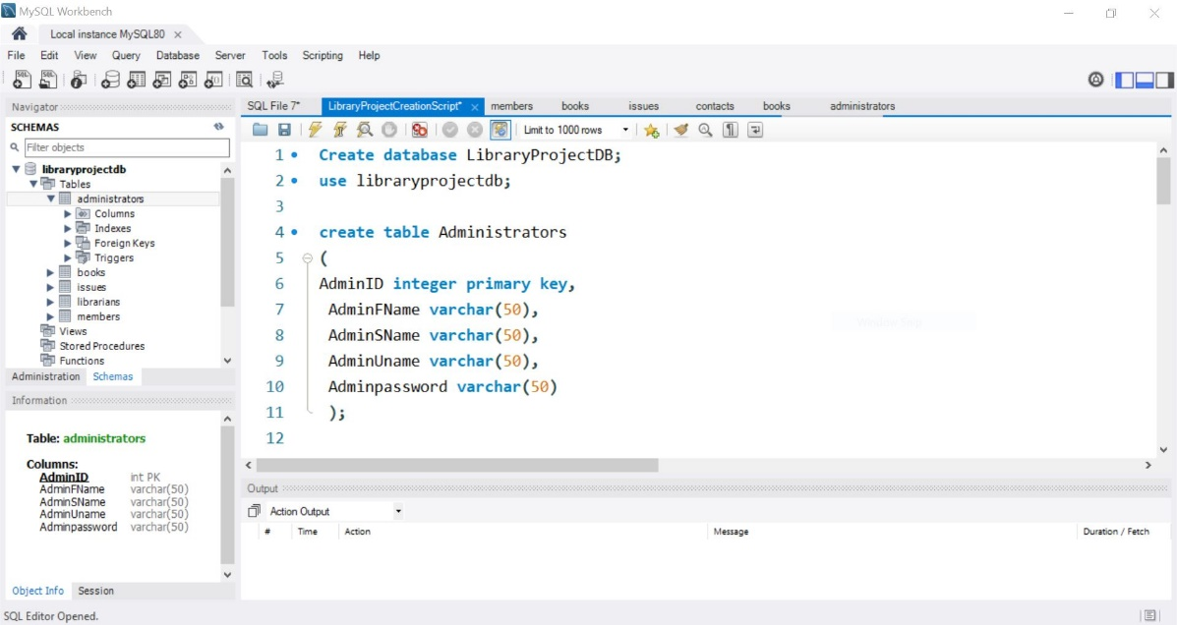
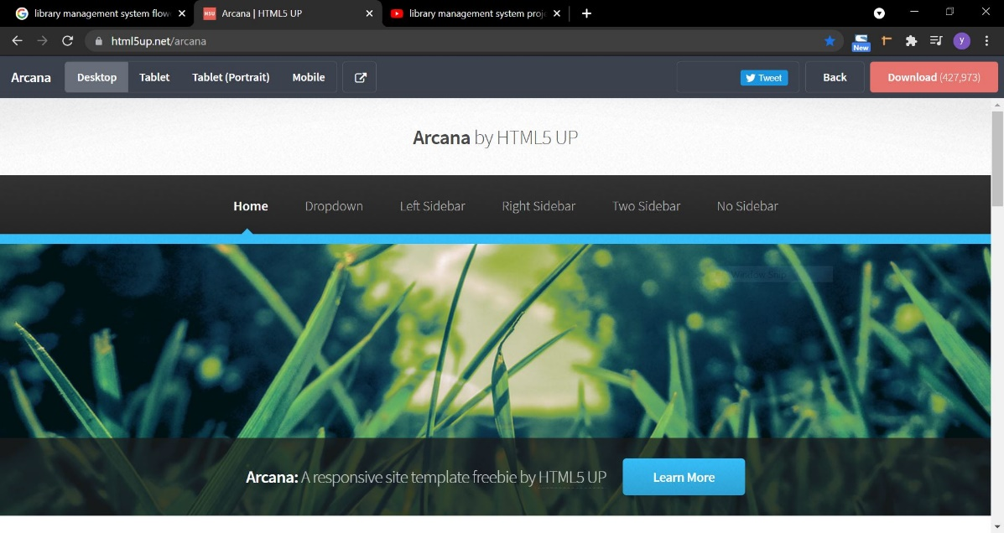
Our Project Process
Stuart - Backend
Yolanda - Frontend

Slide 10
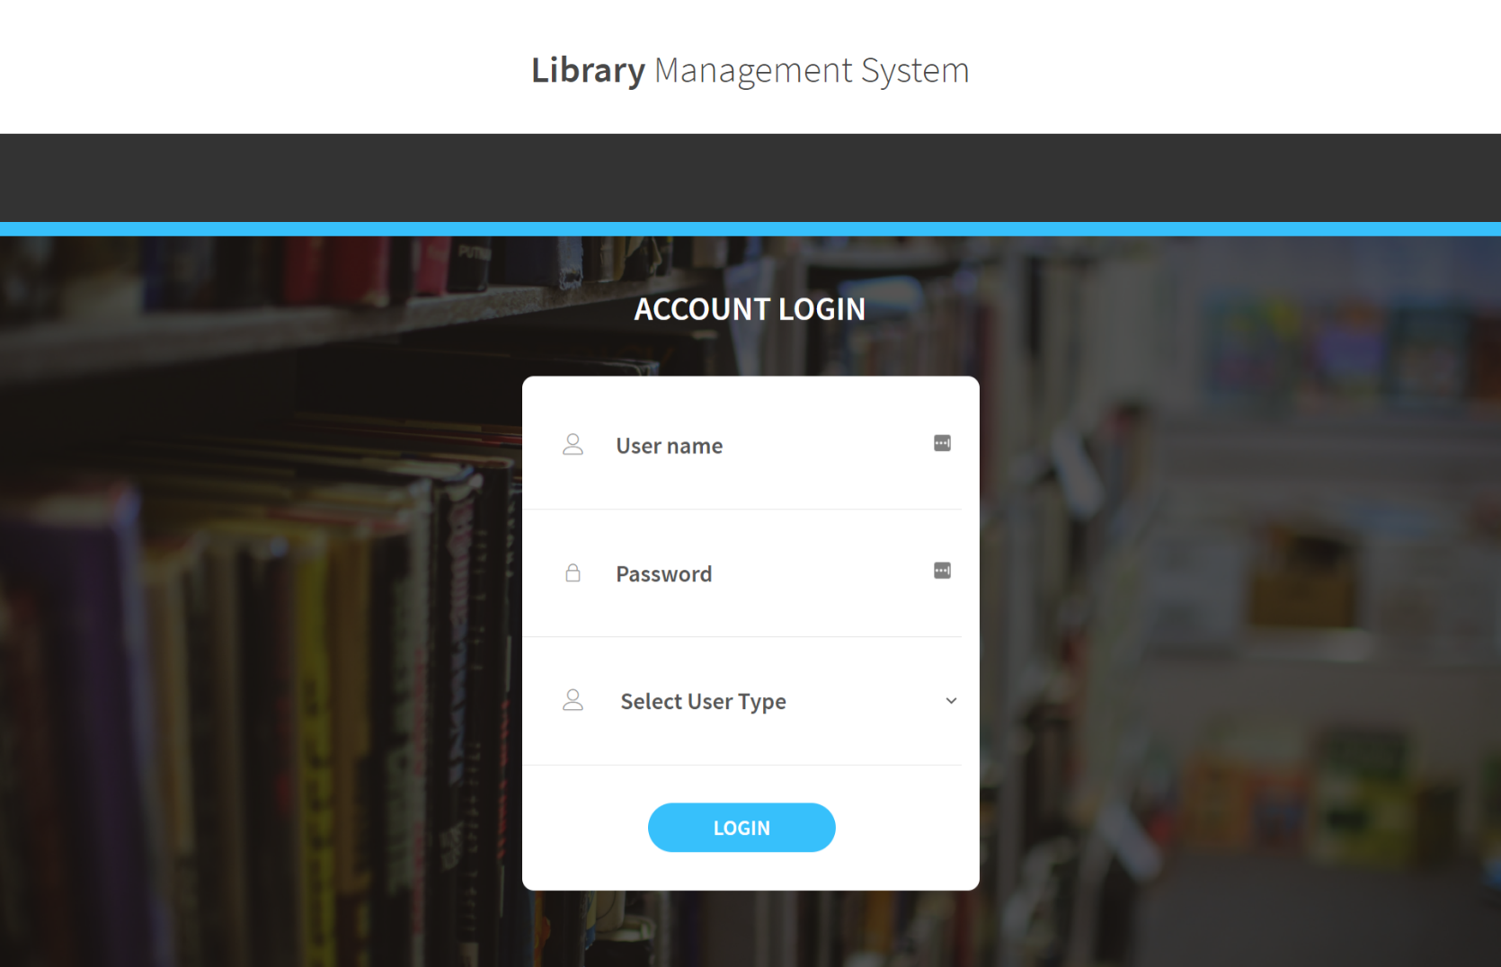
Project Demo

Slide 11
Challenges/Accomplishments
Challenges
Accomplishments
Working with the records to display information from database
Working with a language we are new to working with
Organisation around schedules
Understanding what process was best to attempt the project
Working with CSS frameworks
A functional web application
A web application that can display records from database
A web application that is easy to use and easy to understand
Learned new skills

Slide 12
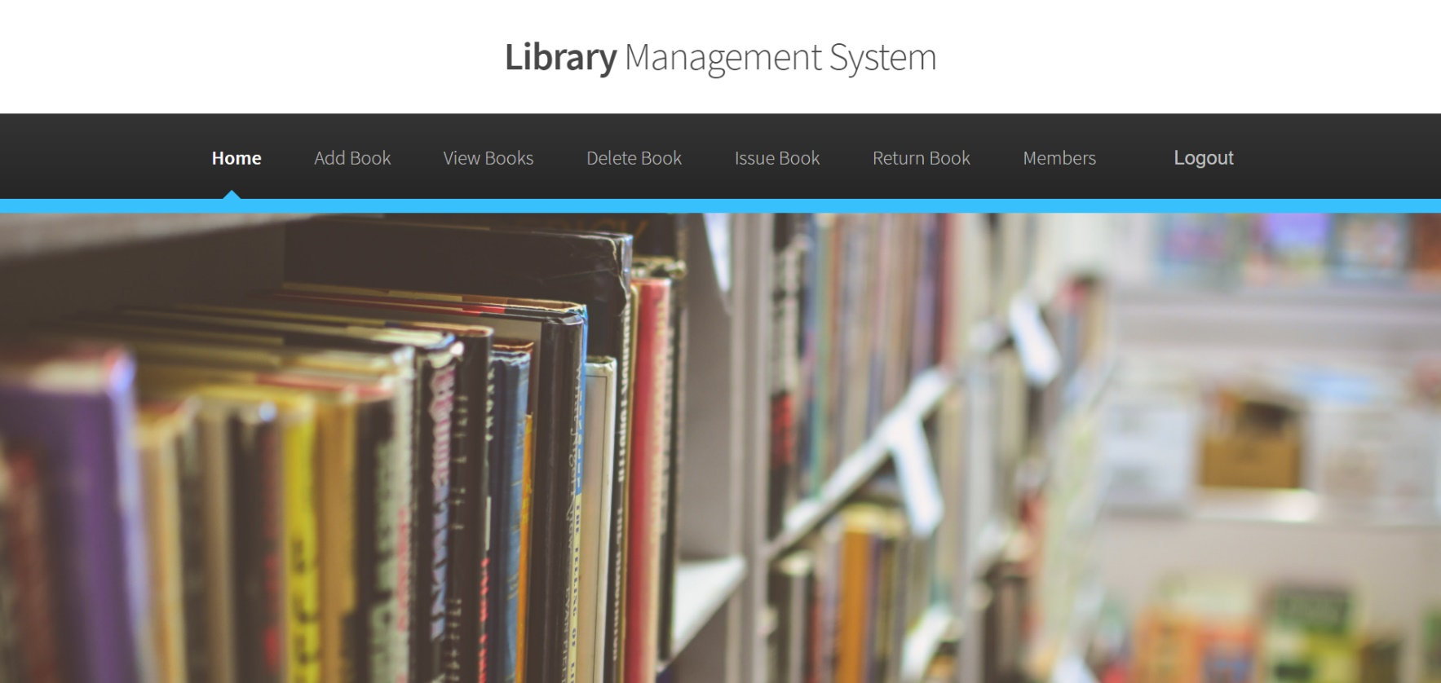
Future developments
Data validation
Searchable options
Issue and return date feature
Late return fine feature
A members login area so they can see
Books available
Books issued to them
Renew books they are borrowing

Slide 13
Summary
Created a library management system
Software can be used to maintain the records of the library
Software can be developed to have more functionality

Slide 14
Thank you!
Yolanda Oliver and Stuart Butler
Any Questions?

